Slide 1
Wednesday, October 26, 2016
Write In Your Agenda:
Write In Your Monitoring Log:
CW:
Review Earthquake PPT notes, Earthquake Crossword, and Word Search
Epicenter location
HW:
None.
Response to Warm-Up:
Compare and contrast the hypocenter and epicenter of an earthquake.
You will need:
Pencil
Earthquake Crossword and Word Search

Slide 2
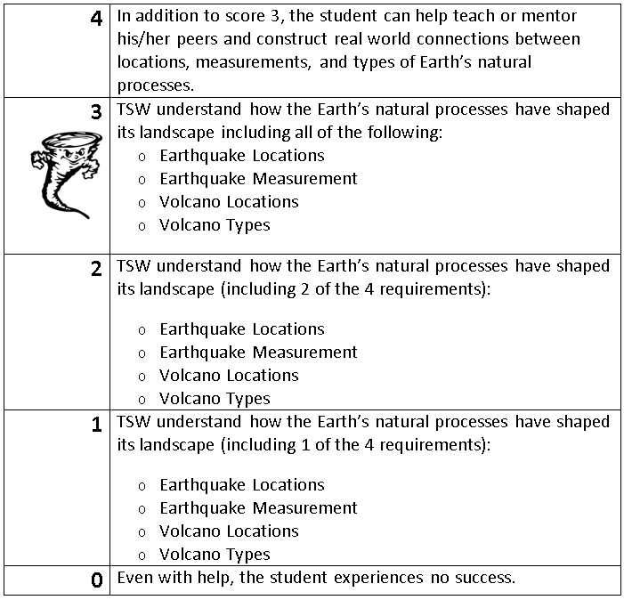
Learning Goal and Scale
TSW understand how the Earth’s natural processes have shaped its landscape (including Earthquake locations and how they are measured as well as Volcano locations and the three types).

